Slide 1



Evolving GIS Education
BayGeo GeoEducators Summit
Feb 23, 2018
Angela Lee
Notes:
I’d like to talk about the evolution of the GIS education landscape and what that means for us as educators. I think everyone would agree that technology generally and “geo” technologies particularly are evolving rapidly.
I think most people would agree this change can present challenges for educators and learners. Then again, one person’s challenge is another person’s opportunity – for the curious among us, rapid change means there’s always something new to explore and we’ll never have to be bored.
I’m old enough to realize that every cliché has a kernel of truth, so I’d like to explore the adage “The more things change, the more the stay the same.”
I’d like to offer a slight variation on this idea, which is
“As some things change, many things stay the same, and the trick is to figure out which is which.”

Slide 2

Technology Is Advancing Rapidly
Web
GIS Integrating and Leveraging Many Innovations
Distributed
Scientific Measurements
Drones
Location
Apps
Surveys
Demographics
Weather
Traffic
Imagery
Real-Time Video
3D
Crowdsourcing
Data
Lidar
Web GIS
Computing
Infrastructure
Mobile
Real-Time
Data Exploration
Faster
3D
Big Data
Hub
Machine Learning
Python
Portal
Apps
Distributed Computing
IoT
Open Data
Web Services
Modern Desktop
Online Content
SaaS
GIS Innovation
Dynamic Image Processing
Cloud
Microservices
Smart Mapping
Networks
Advanced Analytics
Open APIs
Expanding the Power of GIS
Notes:
I think there have been fundamental changes in society and technology that affect the GIS education landscape. I also think there are foundational concepts that haven’t changed significantly, or at least not as rapidly, and these more stable concepts provide a framework for exploring and understanding new developments.
For example, I think it’s safe to say the web has had a huge impact on GIS. It’s greatly increased data availability, changed how we design maps and dynamic visualizations, and changed how we publish and share information.
What hasn’t changed, though, is WHY we use GIS. We’re still using information to answer questions and solve problems.
Equally important, the core functions of GIS haven’t changed. To steal a line from Seth Peery, the verbs haven’t changed We still “collect”, “map”, and “analyze” information. Yes, some of the details of the user interface change. But if we can examine these new developments in the context of what we already know, hopefully the changes won’t seem as daunting.
My colleague David DiBiase recently wrote an article titled

Slide 3
Stop teaching GIS
Teach how to learn GIS instead
Notes:
“Stop Teaching GIS”
His argument is we shouldn’t teach GIS, we should teach how to learn GIS.
Because those darn software companies keep evolving their products and adding new capabilities, we’ll need to keep learning GIS, and so it’s important to know how to learn effectively.
I’d like to offer a slight variation on this idea as well, which is “Stop Teaching GIS. Help students learn to answer questions with geographic information.”
I think the questions and the information are more important than GIS per se.

Slide 4
What has changed?
Implications for teaching and learning
4. Connected
Devices
5. Apps
3. Identity
Software products Platforms & APIs
Client / server Web Services & apps
Stand alone desktop Connected devices
Print maps Web maps, data visualizations
Static data Data services, streams, big data
Custom applications Interoperable packages, libraries
All purpose application Focused apps
Proprietary data Open data & shared services
2. Portal
Online or
On premises
1. Services
Notes:
All right, so if you accept the premise that it’s useful to explore changes in the context of what we already know, we can think about what students should be learning.
Rather than learn how to use ‘a GIS’ that has 10 menus and 50 buttons, we should use an app suited to our particular question that has 3 workflows and a user-experience that is so intuitive you understand what to do next without spending hours on tutorials.
We should learn that the same data and analysis methods can be used in a browser, in a mobile app, or in a desktop app.
We should learn that multiple packages can work together and data can move between applications. So rather than using a single behemoth desktop application for a given project, we use different apps at different stages of the process. We collect data with a mobile app, use the power of a server for computationally intensive analysis, a desktop app to design maps and data visualizations, and a web maps to share the results.
Now I’m not suggesting we no longer need desktop GIS. I am suggesting that it shouldn’t always be the starting point and isn’t central to every project involving geographic information.
My colleagues and I have been thinking a lot lately about what ‘modern’ GIS is and what someone needs to learn to use GIS effectively. This picture shows an information system that is a network at its center. The network could be the cloud, or the web, or an internal network. A key point is at it’s core is a network.
This system is fueled by services – denoted here as #1. These can be data services and they also can be geoprocessing or analytical services. The services are mediated through a portal that manages content, making it discoverable to users and managing access based on the identity of the users (#2 & #3).
Because the data are networked and not stuck on one machine, work can be done in the field, in the lab, in the library, wherever you want, on a phone, a tablet, a laptop – any device that can connect to the network. And there is not a single behemoth app that does the work. There are many focused apps, so you can focus on the task you want to accomplish and not get lost in a maze of menus (#4 &#5).
This system can also be described as a platform, which is one of those wonderful tech words that people use without really being sure what it means. In any case, on the right side is a list of concepts and things that I think most GIS users recognize. As GIS is evolving, software products are evolving into platforms. Print maps are evolving into dynamic web maps and data visualizations. Databases are being joined by data services and data streams. And proprietary data formats are increasingly becoming open and interoperable data streams. My point here is that modern GIS education should prepare students to work with platforms, services, dynamic displays, focused apps, and so on.
So what are the implications of all this for teaching and learning?
I would suggest that both the content and the methods of GIS education should change.

Slide 5
Shiny new concepts
Data Science
UI/UX Design
Big Data
Drones
VR/AR
AI
Crowd sourcing
HPC
Cloud
IoT
GitHub
APIs and SDKs
Notes:
Let’s explore content first. New concepts need to be learned. Many fundamental concepts will remain, but their relative importance and the order in which they are introduced may change.
The evolution of GIS is shaped by the broader technology environment, so basic familiarity with core IT concepts and emerging trends is crucial. Here are examples of concepts that will affect the evolution of GIS. Is anyone using drones now? Do you teach coding with APIs and SDKs?
Another implication of the growth and evolution of GIS is that as geospatial technologies spread into new areas, opportunities exist for those who can combine GIS skills with subject matter expertise in those areas. I mentioned the use of many small, focused apps rather than one large desktop app. Building those focused apps requires really understanding the core concepts and workflows of another industry.
And a world of many, small focused apps assumes there are plenty of people who know how to build such apps. Last March, we conducted a survey of recent graduates to ask how well prepared they felt to compete for jobs involving geospatial technologies. The responses suggested a gap between what they learned in higher education and what they feel they should have learned. The takeaway message is that graduates said they needed more coding, app building, and IT skills.

Slide 6
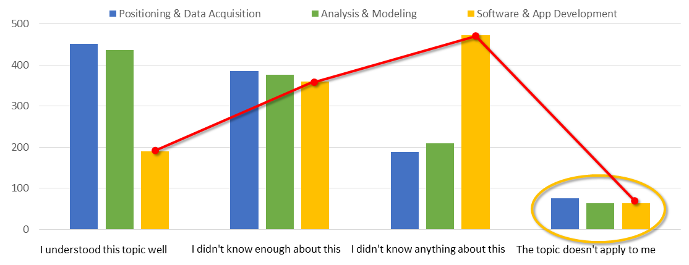
GIS graduates want more coding, app development
Notes:
The survey was organized around the competencies identified in the Geospatial Technologies Competency model, Respondents were asked to assess themselves against the Industry-sector competencies, Positioning & Data Acquisition, Analysis & Modeling, and Software & App Development.
These graphs summarize those self-assessments. Many fewer respondents said they understood the topics of Software and App Development well, compared to the other competencies. A much higher number said they didn’t know anything about this.
Yet very few people said the topic of app development wasn’t relevant to them.

Slide 7
The most important thing to know
is how to learn
Notes:
The most important thing for a GIS professional to know is how to learn. To be able to recognize a situation for which the answer is not clear, and to be able to gather and apply information so that a decision can be made or a problem can be solved.
So how does one learn that? Practice. Lots and lots of practice.
Not only is technology constantly changing, the nature of work is constantly changing, and I don’t just mean because the robots are taking over. Very few people do the exact same task over and over for eight hours a day. Most people expect to move up a career ladder over time, taking on new responsibilities.
Learning is a way of life.
I think the best thing we can do for students is to model lifelong learning. Rather than rely on textbooks and step-by-step exercises, we should use software documentation, blogs, YouTube, and other web resources to answer questions. Help students learn to solve problems the way they’ll do it on the job. I’ll admit I was incredibly naïve when I started working. I assumed there would be policy and procedures for anything I’d be asked to do. It didn’t exactly work out that way.
I had to learn to be comfortable asking lots of questions and experimenting.
I learned it was a lot more effective to find someone with relevant knowledge and ask their help than to go it alone. Even if the other person didn’t know how to do exactly what I was trying to do, they might know how to do something similar, or how to do the first step.
No one can know everything, but collectively, we know a lot. The reason meetings like this are valuable is because we can share what we know and meet others who might help us learn something, either today or some day in the future.
I mentioned earlier that networks are fundamental to modern GIS. I would also suggest that networks are fundamental to modern GIS education.

Slide 8
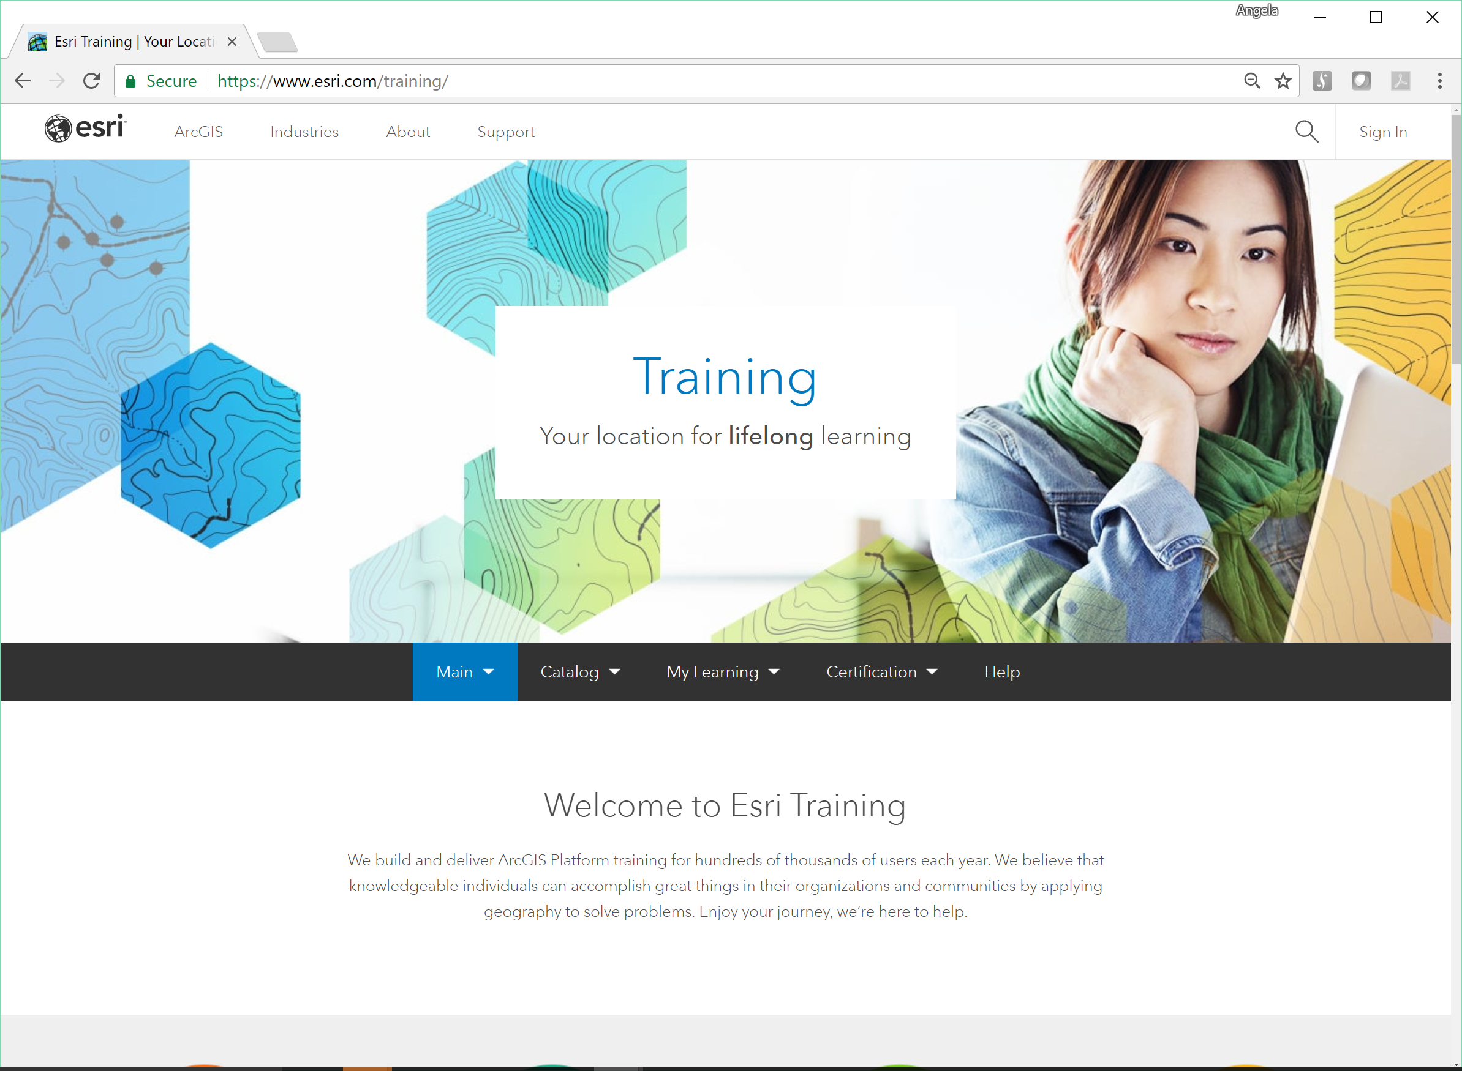
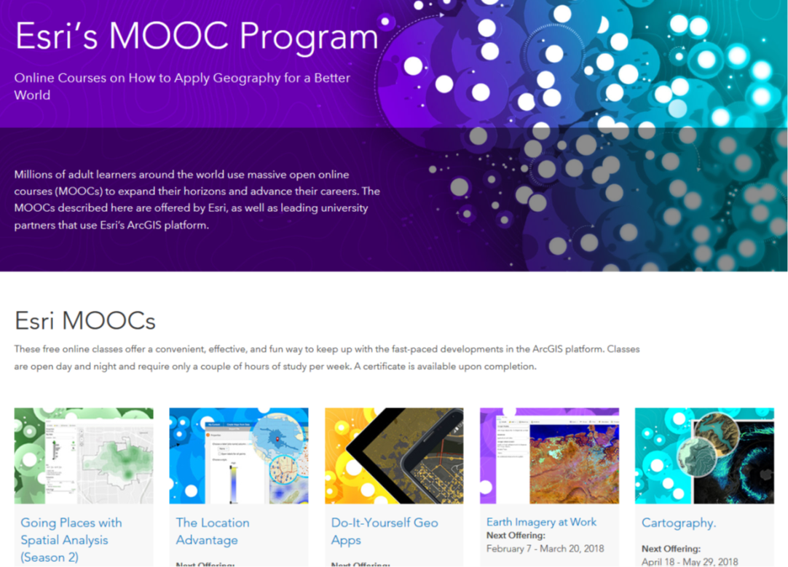
Resources
Training courses, MOOCs
Notes:
When Rina and I met with Rick to discuss the agenda for today, Rick said one of his goals was to provide a clear sense of the resources available to educators and students, so this next section focuses on resources Esri provides for teaching and learning. We have training, as you might expect. We also have blogs, and videos, and code-samples that can be used as launching points for exploration. Most importantly, though, we have a team of people that are part of the GIS education community, and we’re eager to work with you, because we’re all in this together.
Ttaking a deeper dive into specific resources…
About 18 months ago, Esri launched a new training site that brings together all kinds of training resources in one comprehensive catalog. It includes e-learning, instructor led courses, seminars and video, and more. Much of the content, including all of the e-learning content is available at no cost to Esri customers.
We also have MOOCs, which have a social learning component.

Slide 9
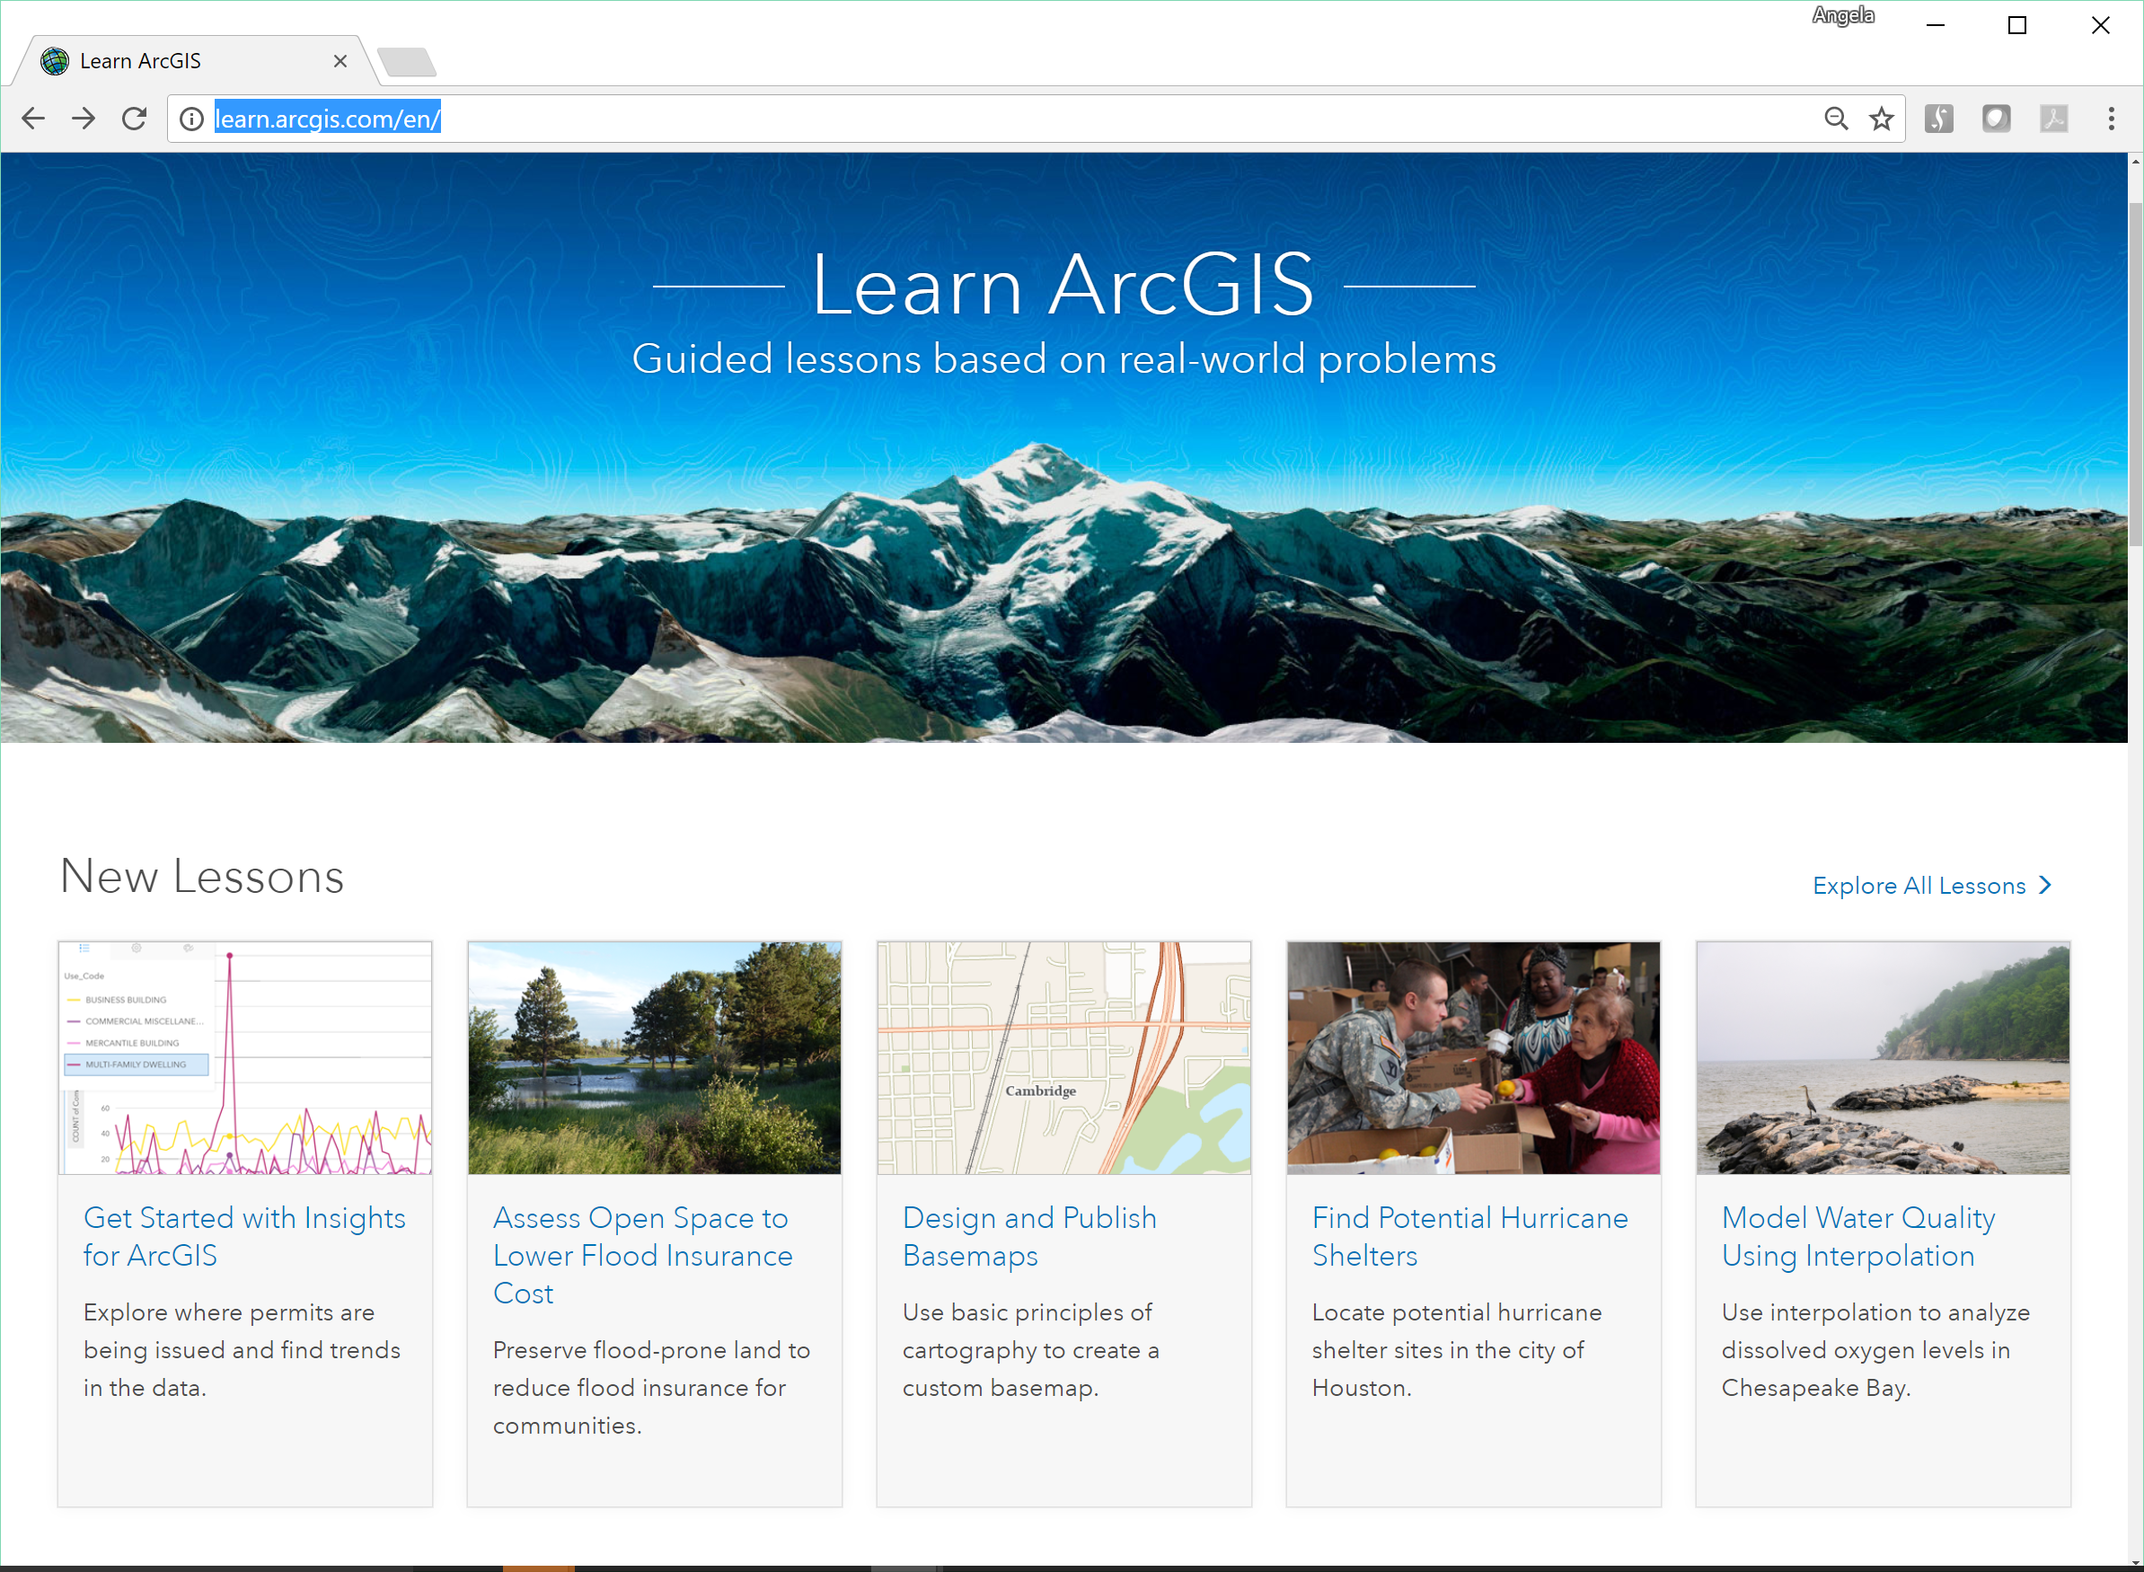
Resources
Training courses, MOOCs
Learn.ArcGIS.com
Notes:
The site Learn ArcGIS provides guided exercises, generally using real-world scenarios and project-based learning.

Slide 10
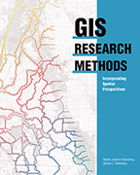
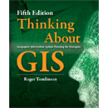

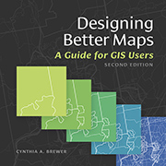
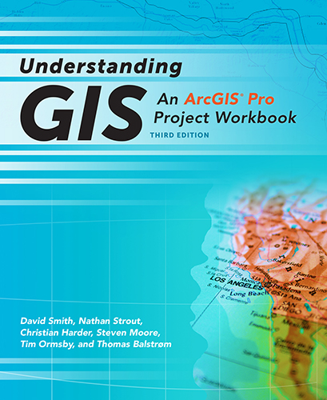

Resources
Training courses, MOOCs
Learn.ArcGIS.com
Books
Notes:
We also have books – and although earlier I said we shouldn’t rely solely on textbooks, I would re-iterate the point that foundational concepts are fairly stable, so reference books provide a good grounding in topics such as map design and spatial analysis techniques.

Slide 11
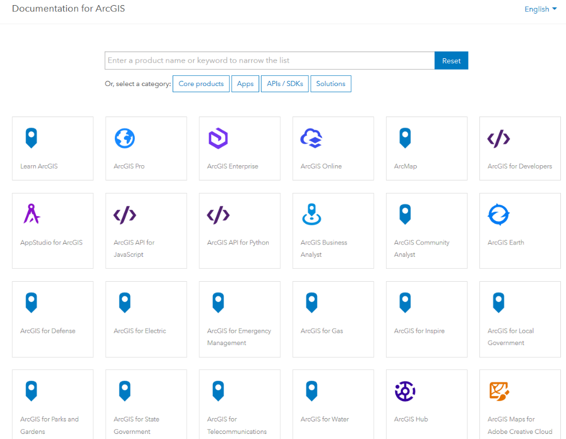
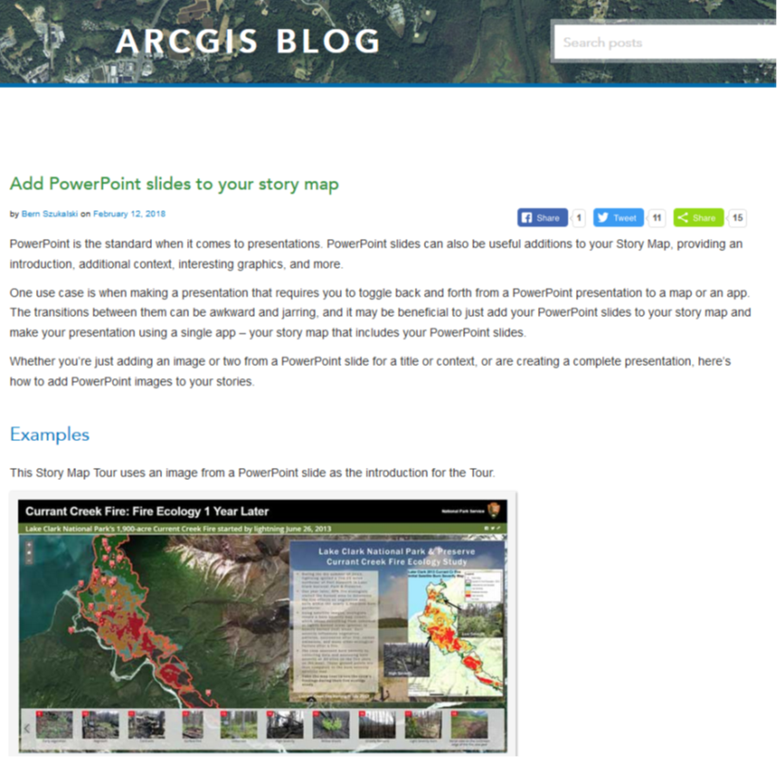
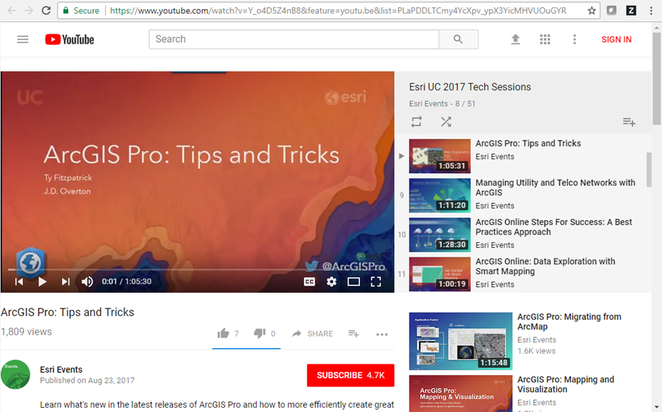
Resources
Training courses, MOOCs
Learn.ArcGIS.com
Books
Doc, videos, blogs
Notes:
When learning the ins-and-outs of software, however, you’ll also want to look at documentation, videos, and blogs. One benefit of these formats is they’re often short and focused, which is great for just-in-time learning and incrementally adding one new skill.
Another huge benefit, though, is they are dynamic and much easier to keep up-to-date than books.

Slide 12
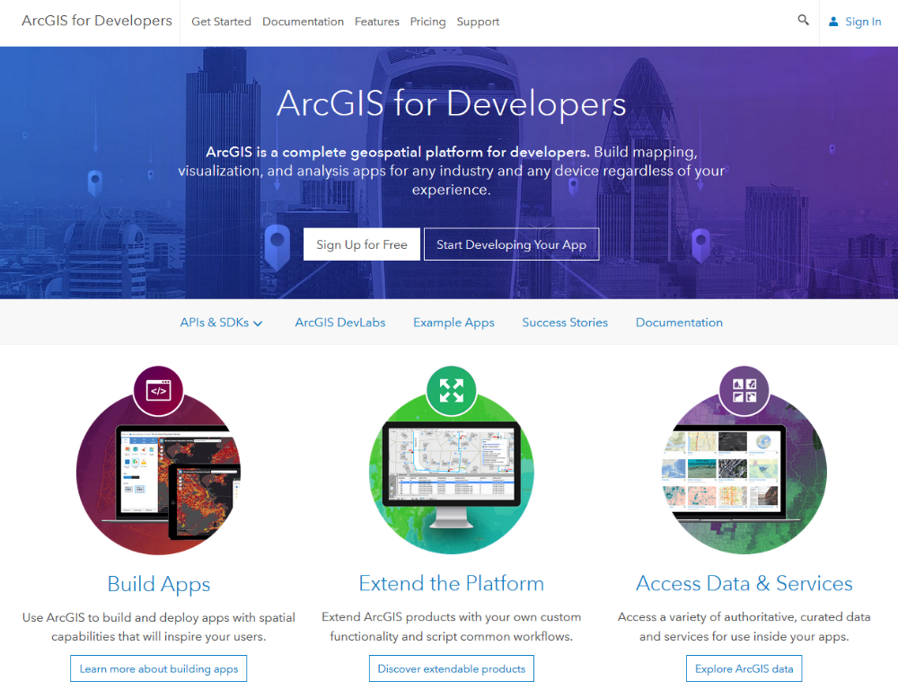
Resources
Training courses, MOOCs
Learn.ArcGIS.com
Books
Doc, videos, blogs
Developer resources
Notes:
We have resources for learning to code and build apps.

Slide 13
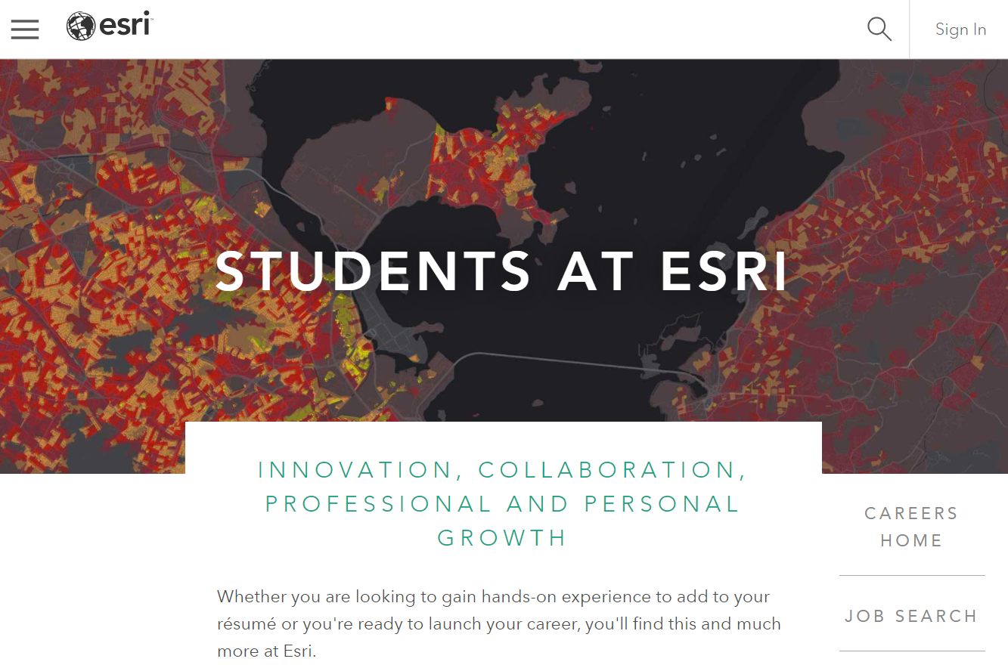
Resources
Training courses, MOOCs
Learn.ArcGIS.com
Books
Doc, videos, blogs
Developer resources
Internships & career advice
Notes:
We have programs for students, including paid summer internships, conference assistantships, and career advice. The conference assistantships enable students to attend events like the User Conference or Developer Summit in exchange for volunteering part time. It’s an opportunity to build a professional network and explore the huge range of career options in both private and public sectors.
We also participate in career fairs and offer workshops that help students distinguish themselves, whether it’s through building a compelling digital portfolio or by honing their networking and interviewing skills.

Slide 14
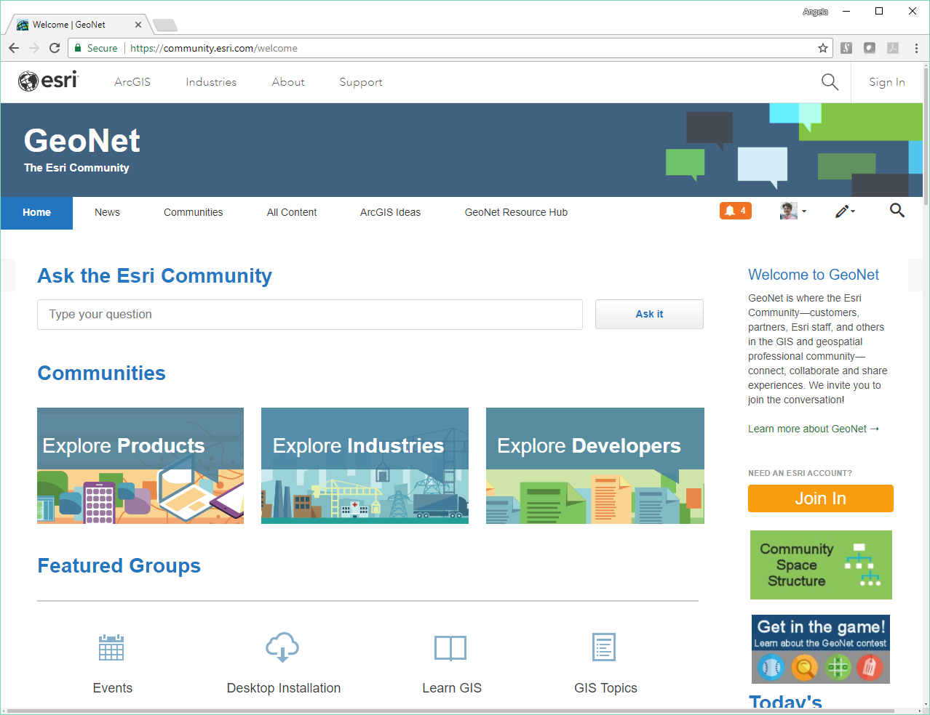
Resources
Training courses, MOOCs
Learn.ArcGIS.com
Books
Doc, videos, blogs
Developer resources
Internships & career advice
Community
Notes:
And we have ways to connect with others, on the web and at events like this. GeoNet is Esri’s community platform, and there are communities through industry associations such as URISA, and through academic organizations such as the Association of American Geographers or the American Geophysical Union.

Slide 15

Resources
Training courses, MOOCs
Learn.ArcGIS.com
Books
Doc, videos, blogs
Developer resources
Community
‘Straw man’ curriculum
GIS Course
Programming GIS Course
Data System GIS Course
…………………………In the making….
Community
Notes:
Finally, something still in the works is what we’re calling a “straw man curriculum.” The goal is to provide a vision for modern GIS education. What are the concepts and skills that should be covered in an introductory workshop or course? In a certificate program? In a master’s degree?
The goal of these documents is to provide a framework for discussion; they’re not meant to be prescriptive. Each instructor and each institution has its own strengths and will structure a course differently. We’ve talked to many instructors who want to update their courses, so these documents are meant as a starting point. As I said, these are “works in progress” but we’ll let you know when they’re available.

Slide 16

Notes:
I want to leave you with 3 thoughts today.
I think a spiral is a useful way to think about change. Earlier I mentioned the adage the more things change, the more they stay the same, which is to say that many things move in cycles. A spiral combines this idea of cycles with growth. As you move around the spiral, you can come back to an idea you’ve seen before, building on it and adding knowledge at the edge, while retaining the stable core.
The second thought is that learning is a way of life. I’m sure that’s not exactly news to anyone here, but not everyone has the same mindset. We can – and should - help our students and colleagues cultivate the mindset of lifelong learning.
And finally, remember the value of networks. Being here in silicon valley, I’m sure you’re all familiar with Metcalfe’s law regarding network effects. It states the value of a network increases with the number of connected users. So look around and remember we’re stronger together.
Thanks again to Rick for inviting me to participate, and thank you for your time.

Slide 17
References and resources
Stop Teaching GIS
GIS Grads Want More Coding
Training.esri.com
www.esri.com/mooc
Learn.arcgis.com
Esripress.esri.com
esriurl.com/deskcopy
Doc.arcgis.com
YouTube.com
www.esri.com/video
Blogs.esri.com
Careers.esri.com
Community.esri.com

